Slide 1
“Moonbit” HaPoP ‘18
James E. Dobson and Rena J. Mosteirin
Dartmouth College

Slide 2
“Code Hermeneutics” James E. Dobson
“The reasoning behind this part is involved, taking into account that the words may not be signed corrected.”
—AGC Source Code

Slide 3
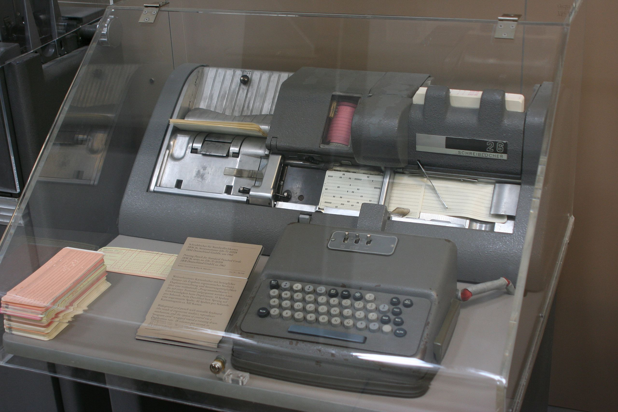

Slide 4
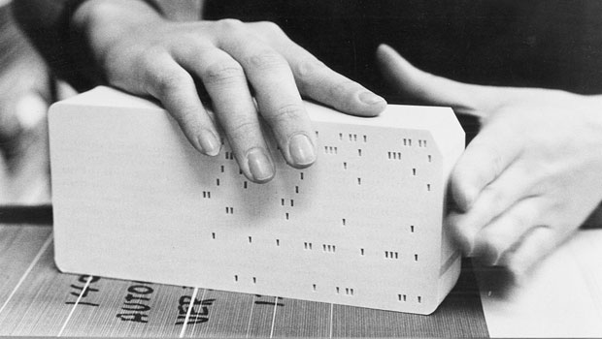

Slide 5
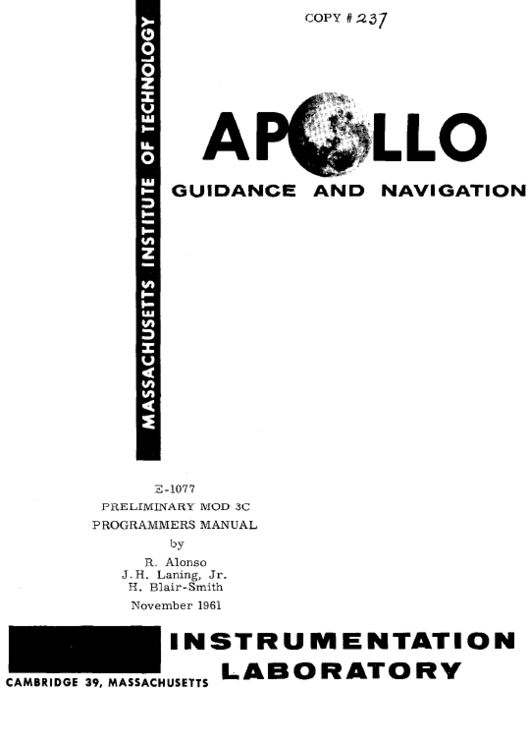
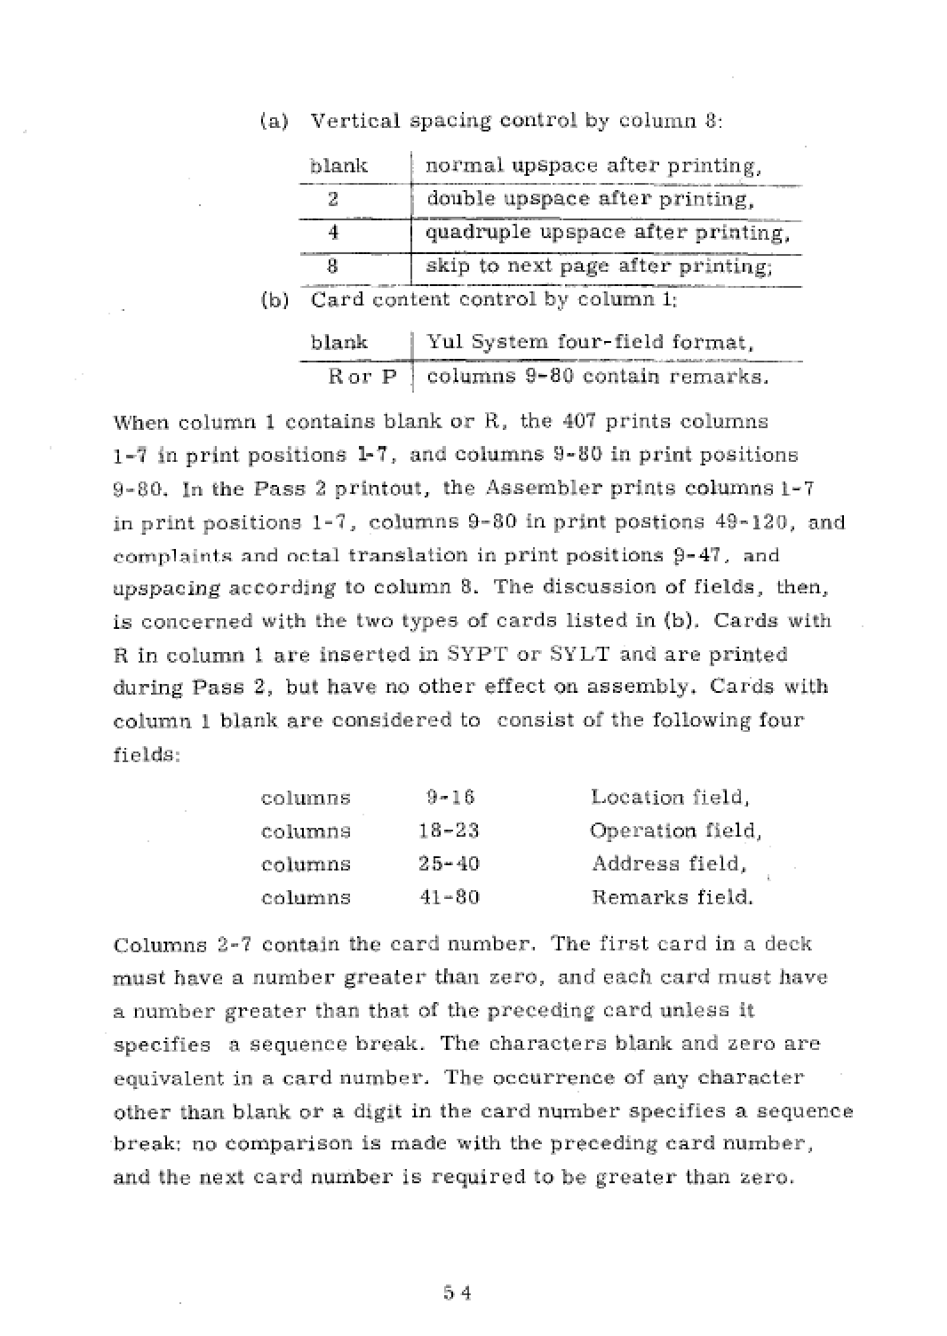

Slide 6
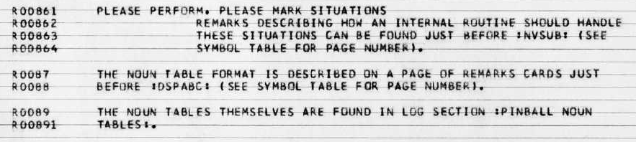

Slide 7
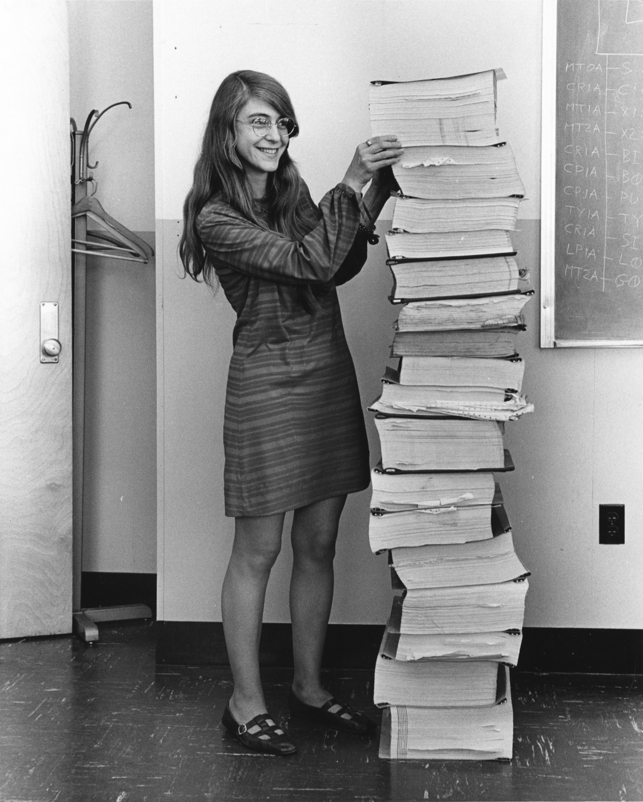
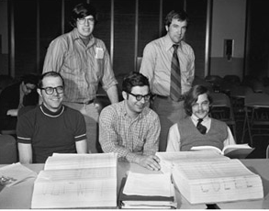

Slide 8
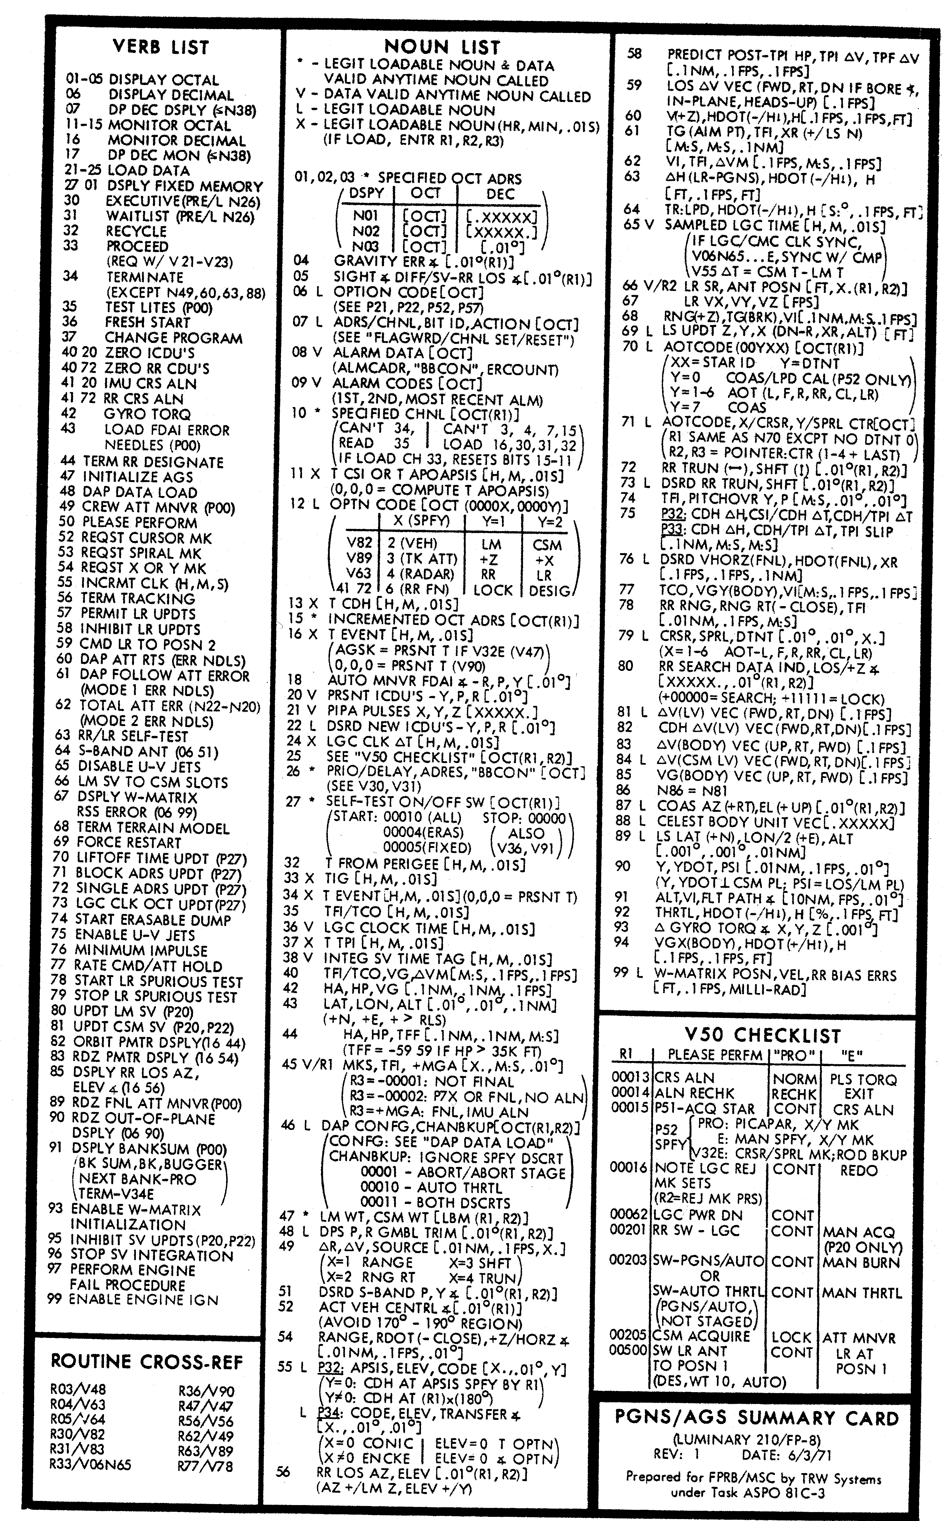
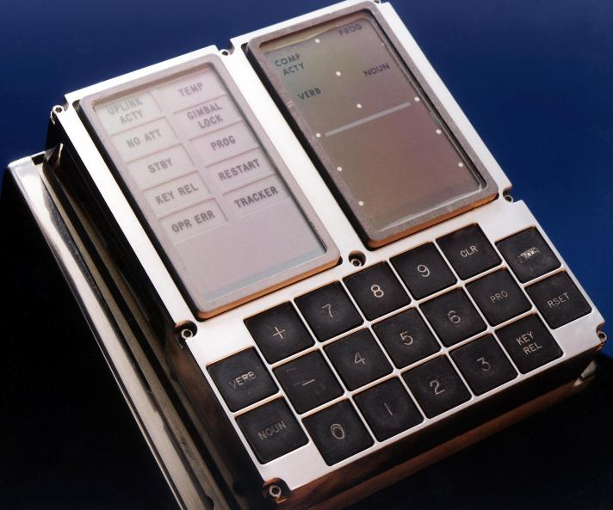

Slide 9
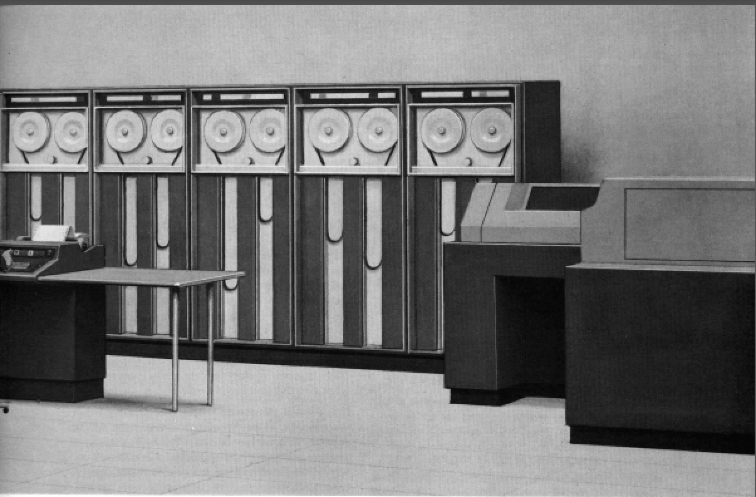
Honeywell 1800

Slide 10
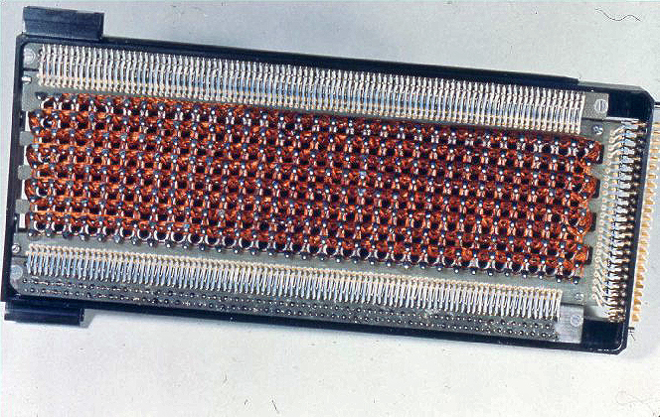

Slide 11
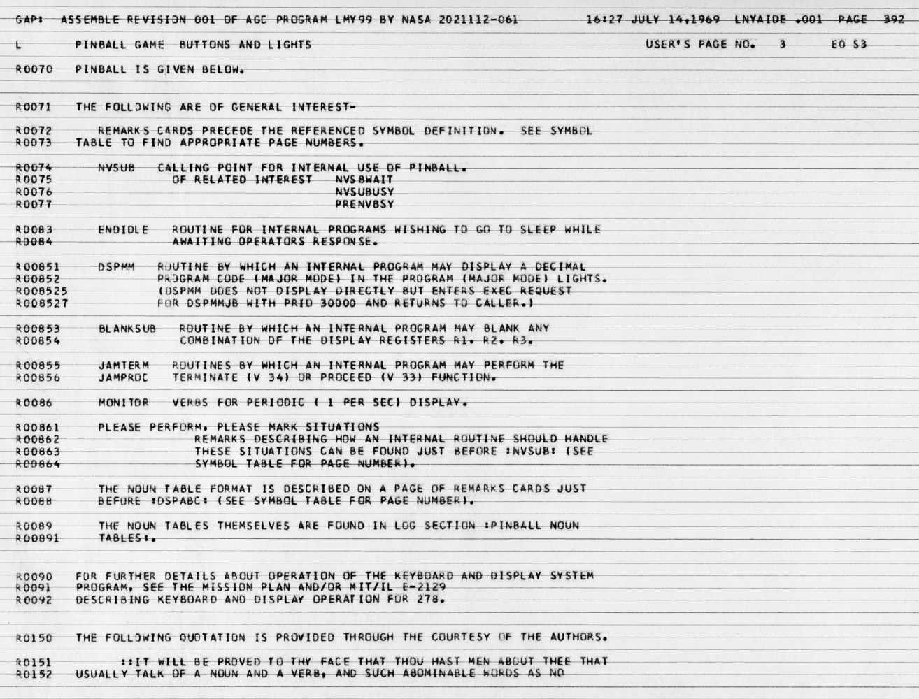

Slide 12


Slide 13
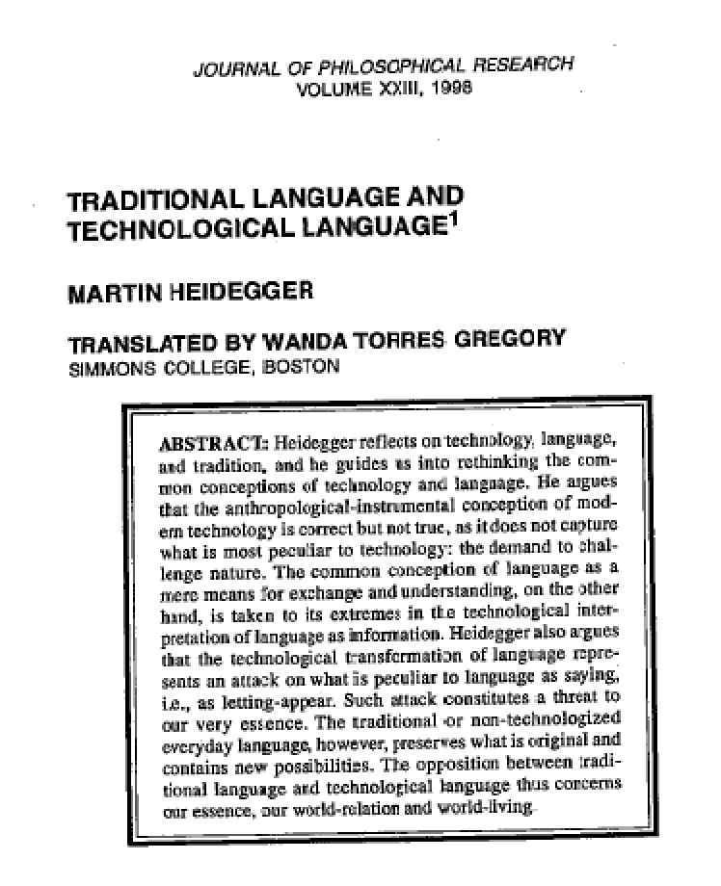
“The handing down in tradition is not a mere passing on, it is the preservation of what is original, it is the safeguarding of the new possibilities of the already spoken language” (142).
“The handing down in the tradition of a language is realized through the language itself, and indeed in such a way that, for this, it lays claim to the human being to say the world anew from the language that is preserved and thus to bring what is not-yet-seen into appearance” (142).

Slide 14
This side of the book, Computer Lib proper (whose title is nevertheless the simplest way to refer to both halves), is an attempt to explain simply and concisely why computers are marvelous and wonderful, and what some main things are in the field.
The second half of the book, Dream Machines, is specifically about fantasy and imagination, and new techniques for it. That half is related to this half, but can be read first; I wanted to separate them as distinctly as possible.
Ted Nelson, Computer Lib/Dream Machines (1970)

Slide 15
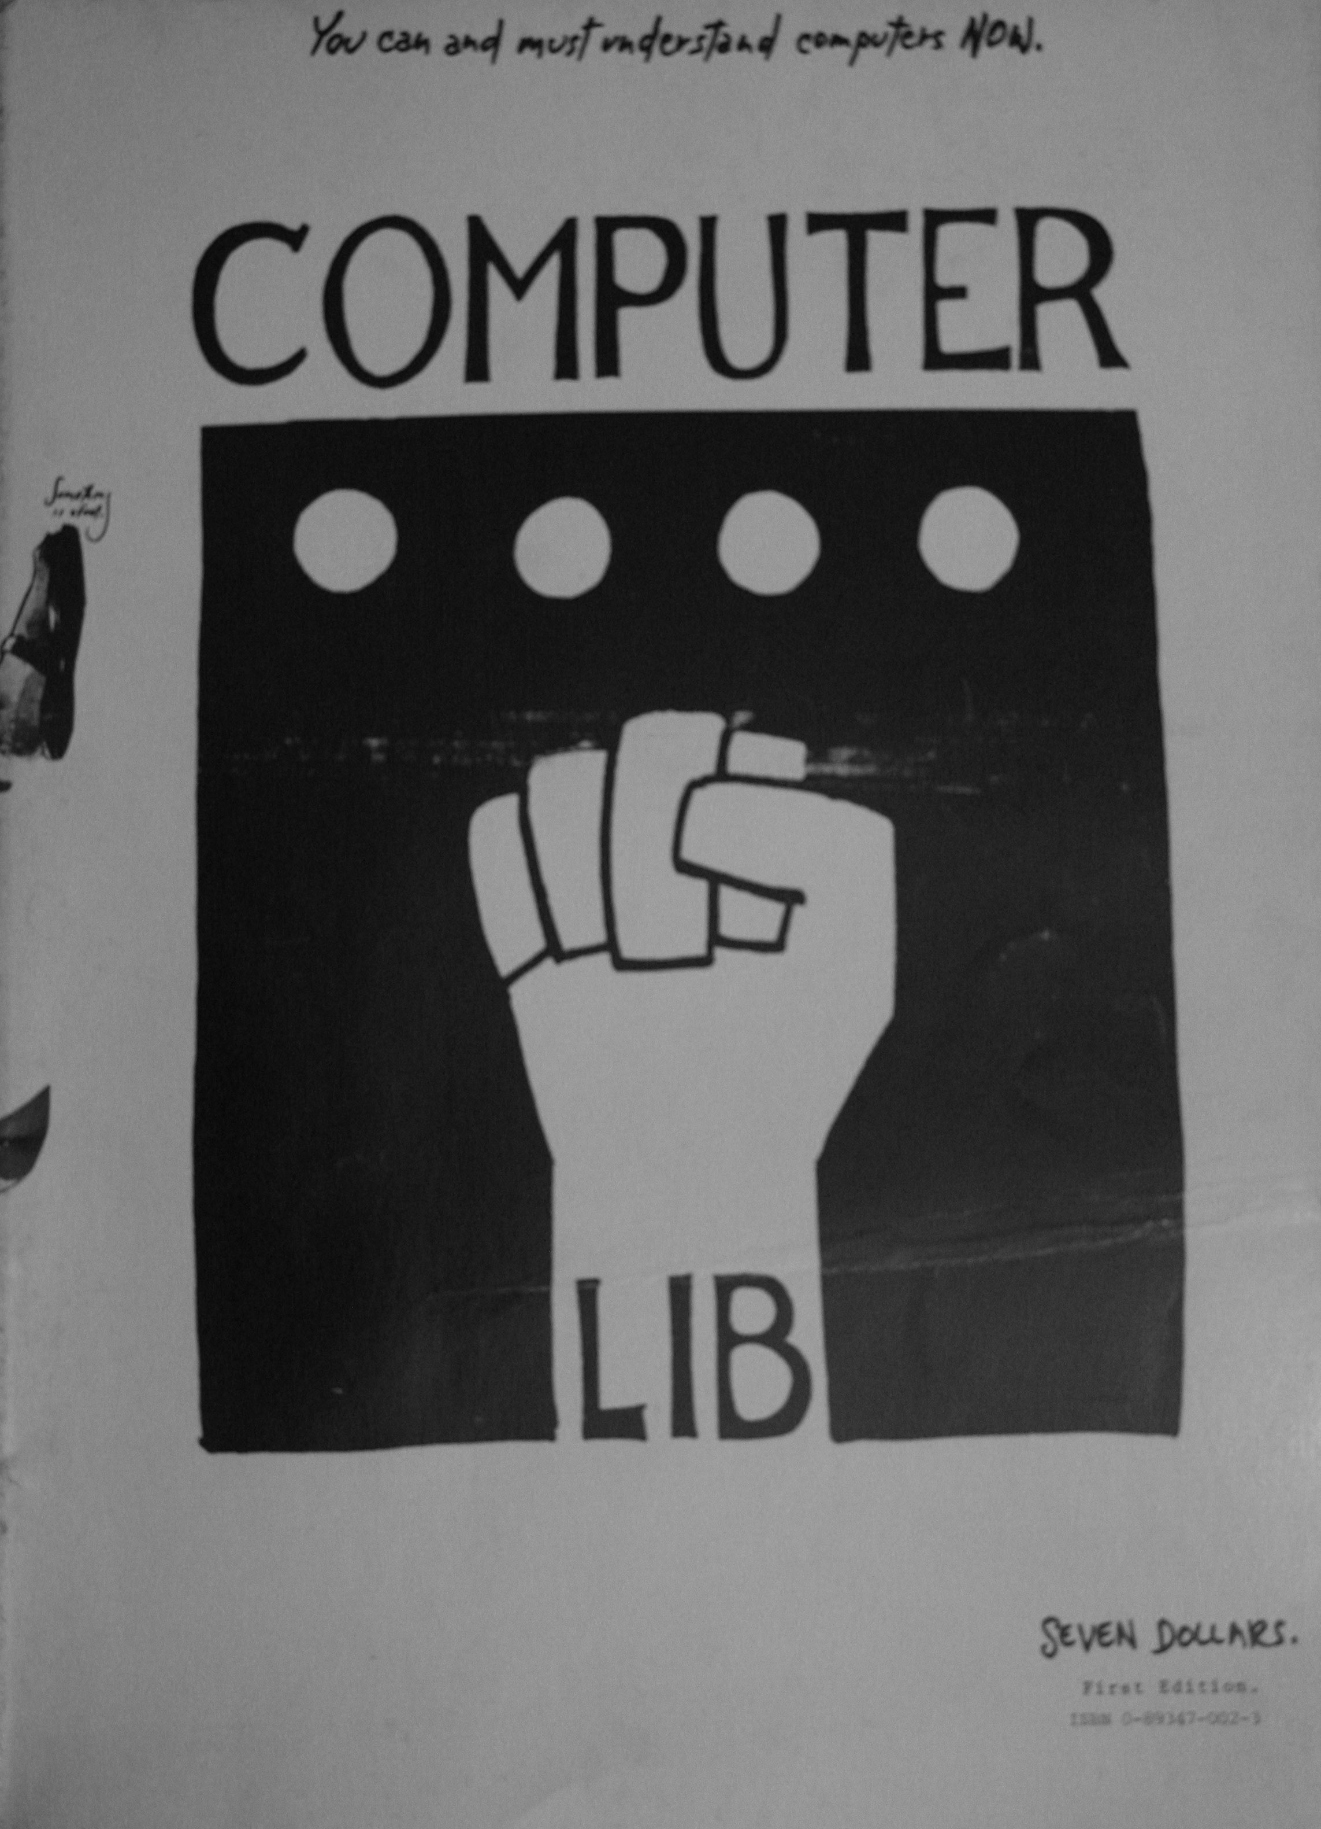
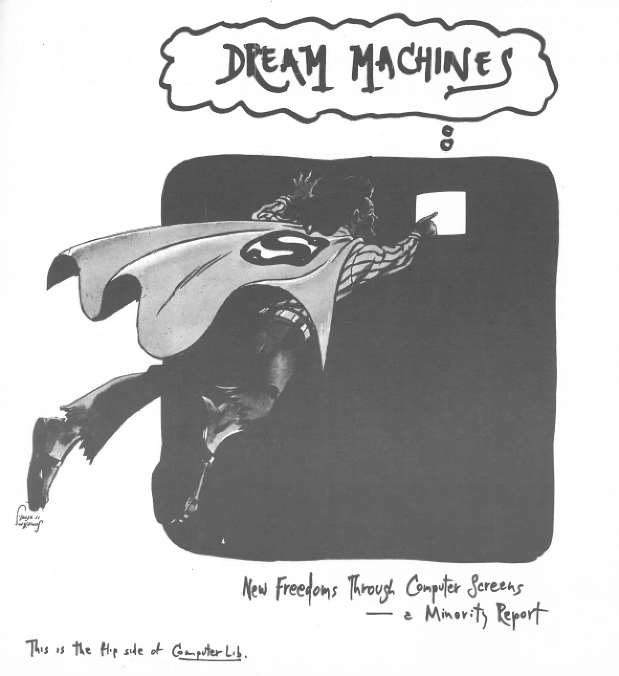

Slide 17
Rena J. Mosteirin

Slide 18
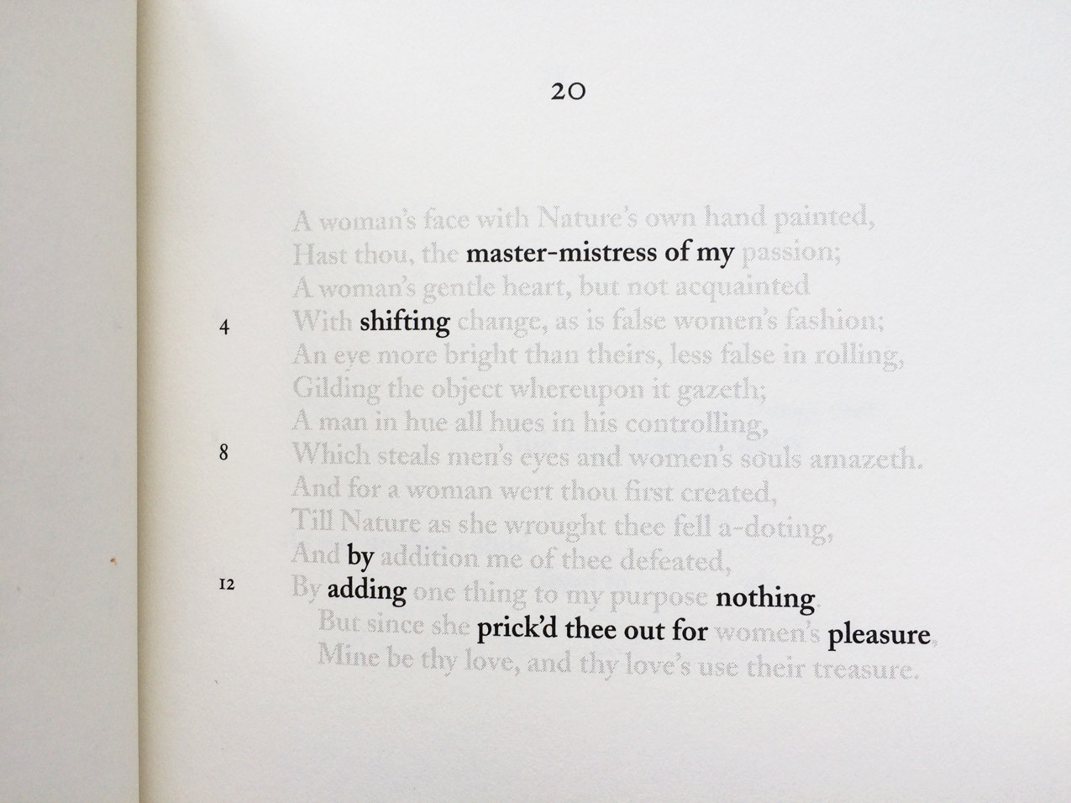

Slide 19
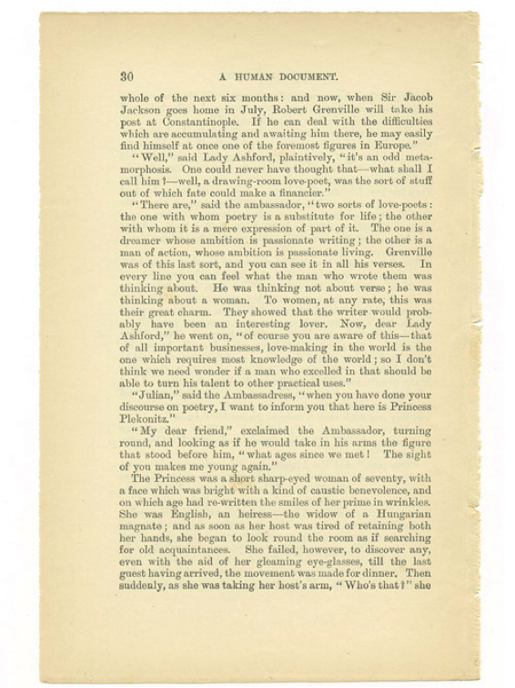
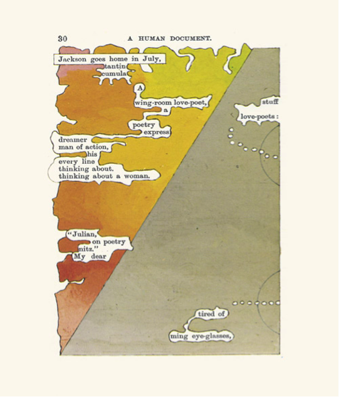

Slide 20
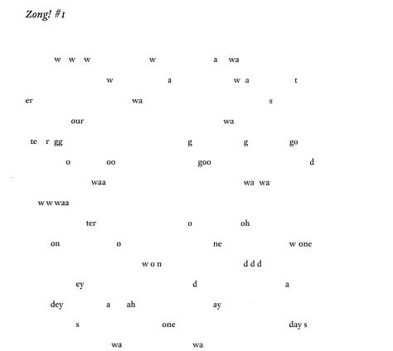

Slide 21
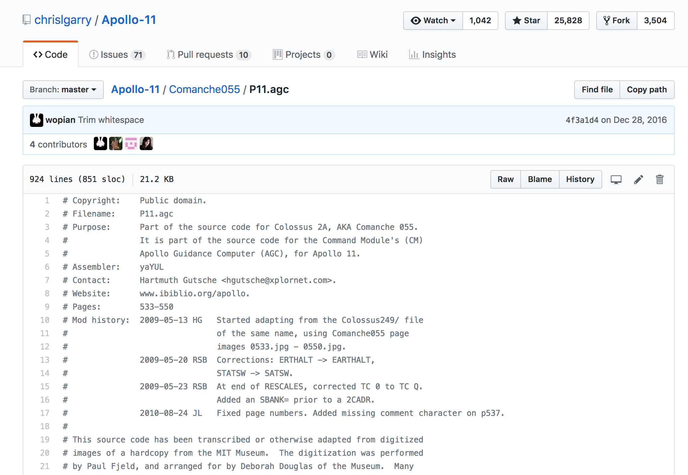

Slide 22


Slide 23
Fresh Start
Slap1
Man initiated fresh start
execute startsub
clear fail registers
initialize flagwords
goprog major code change enema
Mr. Klean comes here from pinball
does most of the work
same story
P00KLEAN GOJAM
we are in a restart loop
MASK EXTEND START
(This might happen again)
Enema killed waitlist
and biases thus
Do not use enema without consulting P00H people
Depressed rand reject
standby
GOTOP00H rendezvous
to continue
from astronaut

Slide 24
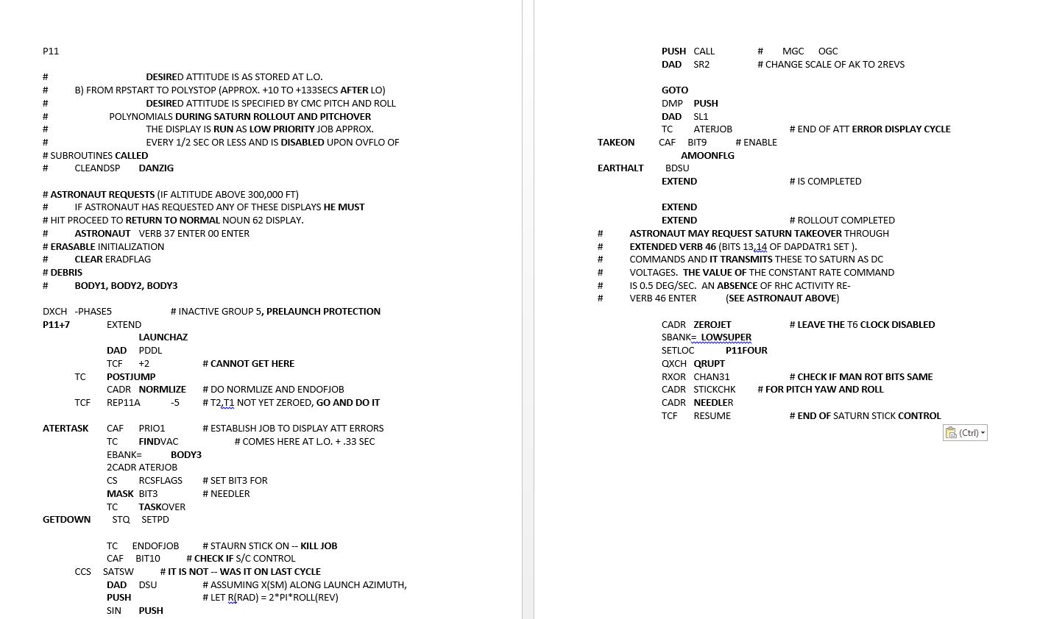

Slide 25
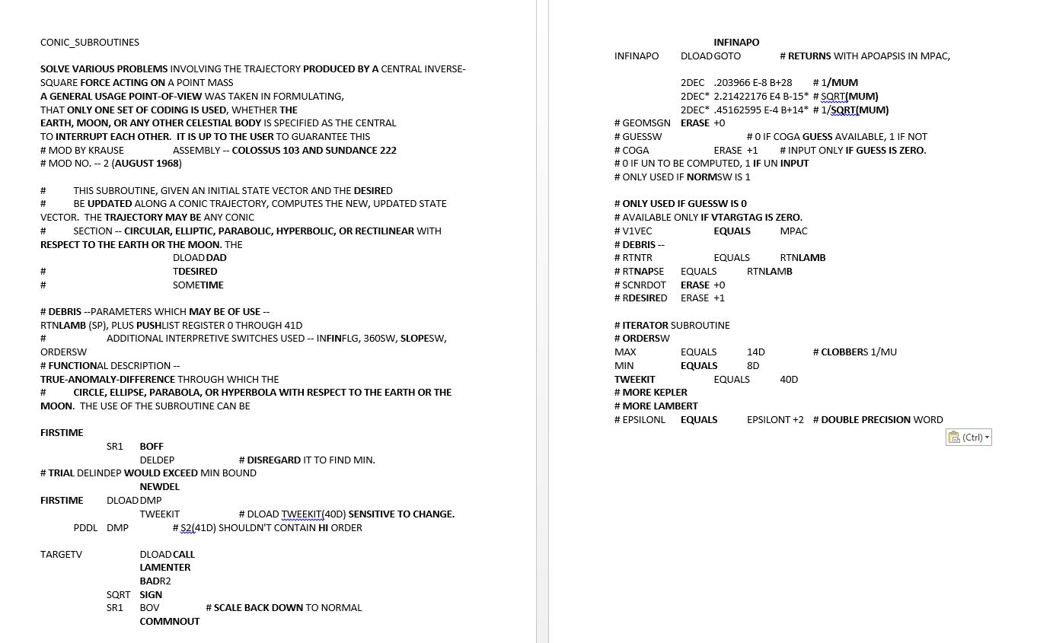

Slide 26
